Slide 1
Astro Brewing Co.
Team D In-Person MSBA
11/2/20
David Chen Lee, Jerry Yang, Himangini Banwari, Jessica Zhang, Michael Chung
Astro

Slide 2
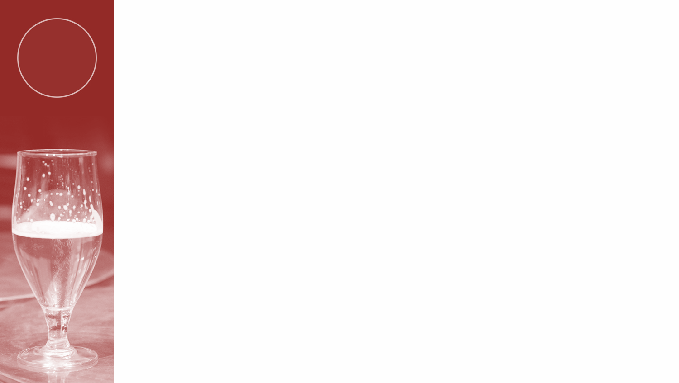
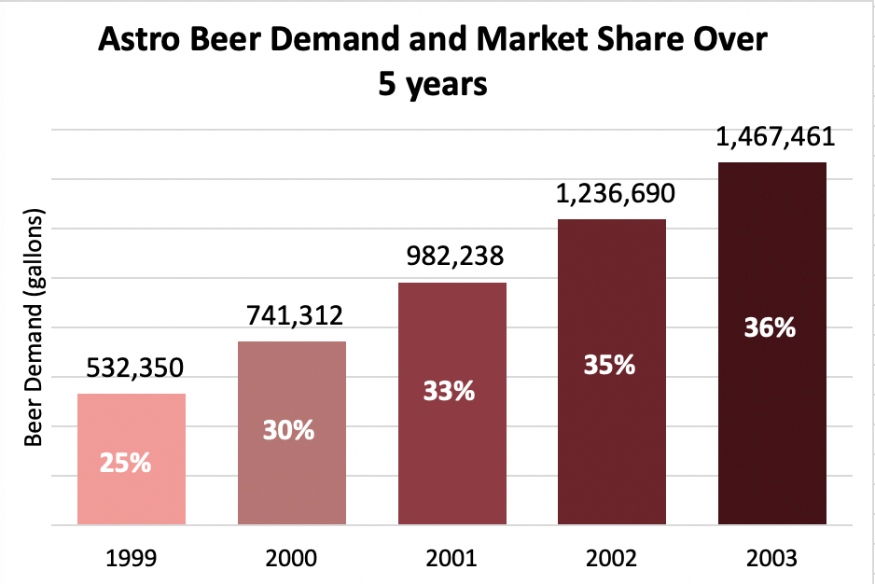
Estimate Sales Data
Astro
From the population over 21, average consumption rate, and estimated Astro market share
Notes:
Himangini

Slide 3
Sensitivity Analysis
Astro
 | Probability | NPV (thousand $) | NPV(without tax) (thousand $) | NPV(wages=400,000) (thousand $)
High(150%) | 30% | 3,126 | 4,438 | 3,344
Medium(100%) | 50% | 1,298 | 2,173 | 1,516
Low(50%) | 20% | -529 | -92 | -312
Total | 100% | 1,481 | 2,399 | 1,699
Assume price for bottles(12 pack) is $6.4 per gallon
Assume cost of capital rate 7.5%
Assume cash basis method
Tax is big proportion of expense, which decreases profit around ⅓
Wages = 400k, covers total cost
Notes:
Jerry, Michael
3 million 126 thousand

Slide 4



Conclusion
Astro
Observation
The return before tax based on asset (ROA) is larger than average(10%)
The NPV calculated is lower than initial investment cost ($1.6M)
Expense for the salaries is too high
Recommendation
Based on our data so far, we don’t recommend to invest unless:
The price for Astro Beer increases to $6.6 per gallon
If the wages could cut down to $400,000, the project would be profitable to invest in.
Notes:
Jessica, David
which our company outperforms the market; however which company cannot cover the costs; And resulting in lower performances for the company.

Slide 5
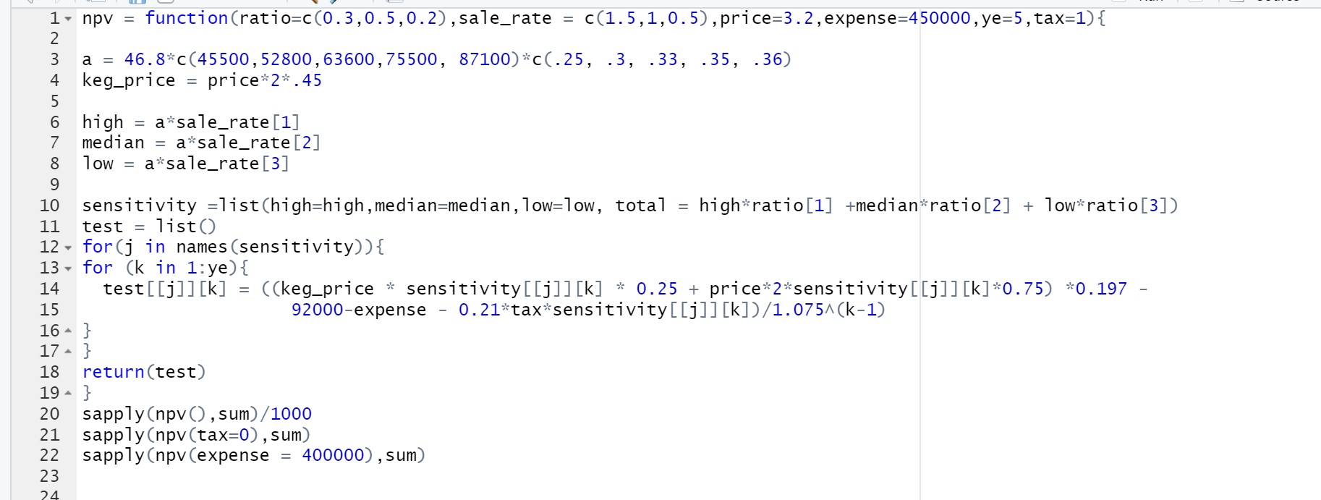
Appendix - Calculation of Sales

Slide 6
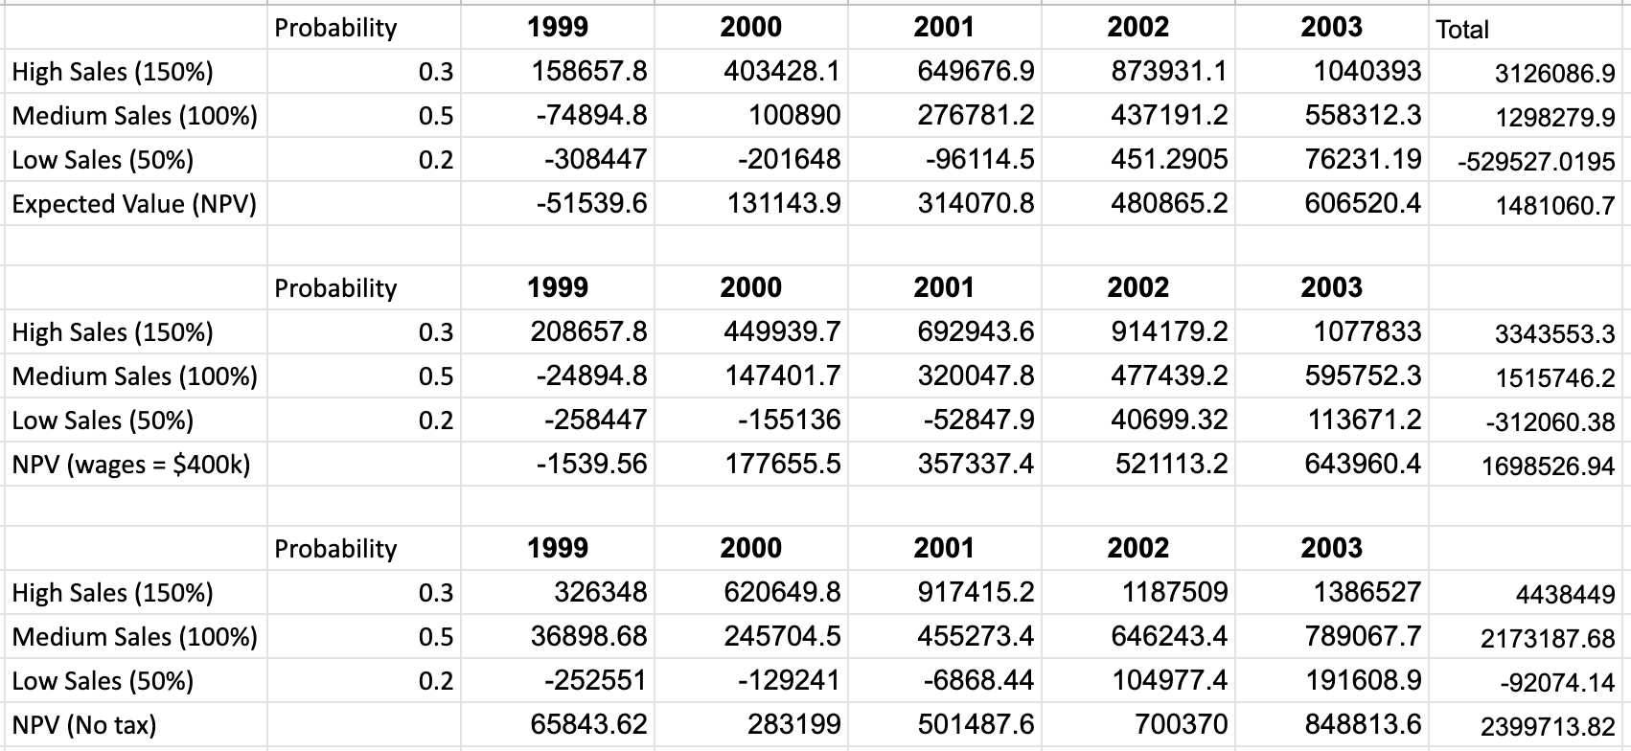
Appendix - Calculation of Sales
Astro

